Slide 1
GIT Revision Control
All engineering IS software engineering in disguise.
Notes:
Provocative! All engineering involves creative input, be it text, graphics, processes , simulation .
Common to all is the ability to undo, revise, enhance partition effort and merge products the effort to create the whole engineering task/product/app/goal. Even graphical tools that don’t appear to be text, still have a revision control.

Slide 2
What is GIT and WHY would I use it?
You need to Spell to Write.
You need Arithmetic to Do Accounts,Use SpreadSheets or Calculate.
You need Algebra to do Mathematics
You need Revision Control to write ANY Software Source.
Coding never is written in ONE edit. It never works first try… If it does…
It evolves, gets new features … and gets bugs and breaks just before HAND-IN
Is usually a team effort… On many computers. As a result…
Many Copies of source files are created.
Revision control manages file distribution , edits and merging.
GIT is the easiest,widely available, most professional, Open Source (free!) revision control
Notes:
Software source can be taken loosely here. Source editing is an iterative process and when in a team development setting ,involving multiple files, handling sharing and merging individual files in a project needs a tool to help coordinate working (and broken!) Project states. In the case where the same file is being edited by two , or more people, merging the files back to one authoritative file is required. Today GIT is widely used throughout industry.

Slide 3
Coding
Facebook,Instagram,Twitter X all started with…
A few files written by …
possibly just 1 engineer.
By the time you knew them…
There are zillions of files and coders! In Twitters case… Not so many Coders,
Bugs and Frequent REVISIONS are needed to fix or refactor or stage new features.
Notes:
By the time you know them they are colossal file and directory structures written by “zillions” of engineers! In the case of Twitter less so now, and due to swift new features Elon had the remaining softies write, IT broke! and they quickly changed their minds on the new changes. Once a working project or widely used application is critical to all , It becomes very very important to be able to revert to the version that last worked!

Slide 4

But I’m not writing TwitterX you say!
Me
myPie.py
myPie.py
Notes:
You start with one file myPie.py. add some 50 lines it soon works completely…

Slide 5

All coding starts simple!
Me
Me
Pete
Pete
E-mail
E-mail
myPie.py
myPie2.py
myPie1.py
myPie.py
Notes:
You start with one file myPie.py. add some 50 lines it soon works completely… you email it to your project team buddy Pete. Why not!? Email is so easy to attach that one file!

Slide 6
Both are writing! Productivity!!!!
Me
Pete
myPie.py
myPie.py
myPie2.py
myPie1.py
petesPie1.py
petesPie1.py
myPie2.py
myPie2.py
Notes:
Pete saves your attached file, and fixes a bug you missed and ands some proposed features you might not want so puts them in a renamed version of your file. He emails both back.You try to add Pete’s source and add features of your own.

Slide 7
Pete needs my new stuff! Swoosh!
Me
Pete
myPie.py
myPie.py
myPie2.py
myPie1.py
E-mail
petesPie1.py
petesPie1.py
myPie2.py
myPie2.py
E-mail
Notes:
You e-mail Pete your new files!

Slide 8
I need Pete’s stuff . Swoosh!
Me
Pete
myPie.py
myPie.py
myPie2.py
myPie1.py
E-mail
petesPie1.py
petesPie1.py
myPie2.py
myPie2.py
petesPie1.py
E-mail
myPie2.py
Notes:
Pete e-mails you just 10mins before hand-in!

Slide 9
Hand-in looms 😭
Me
Pete
myPie.py
myPie.py
myPie2.py
myPie1.py
petesPie1.py
petesPie1.py
myPie2.py
myPie2.py
petesPie1.py
myPie2.py
Notes:
Now! I can’t see Pete’s directory (green box) and he can’t see mine.

Slide 10
Whose/What files do you hand in?
Hand-in is in 10 mins!
You could spend hours opening all files to see which one.
If you do do this linux:Mac sdiff can compare files and show what the differences are.
But don’t! This is the dark side! The force will not be with you.
Notes:
Which files work and which do you submit. Hopefully one of the files HAS a comprehensive test suite so you KNOW it works.

Slide 11

Notes:
A tool to manage all the source files , assets and directories in a project.
It can be a simple a 1 file.
It can be only you that edits it.
It can be only on your computer.
BUT!
It can be any number of files.
It can be any number of team members.
It can be running or being developed and debugged on any number of computers.

Slide 12
How does GIT help?
The simplest way GIT helps is to get STUFF!
Most useful libraries you need for Arduino/Python/C/C++ are on the Web.
They usually come with many files and directories
They often change over time … bug fixes and enhancements
Note the suffix .git
To just download to your computer…
C:> git clone https://github.com/micropython/micropython.git
Notes:
The simplest introduction to git is to ‘grab’ a copy of a library/code from the web.
Git works with repositories (repo’).
A repo is a directory or directory hierarchy that contains source files and resources.
The whole caboodle is managed as one entity.
The only git common you need is in blue.

Slide 13



git init mkpie
Me
Me
mkPie
.git
Notes:
Git repos are both local and remote. Local when you are creating or using the file.
Remote when you need to share or backup the source files.
You can create a git repository with one simple command
It can work with OTHER git repo’s … You have to be a Software Guru tho!
It can and should ignore binary files you generate as well as others.
NOT ALL FILES ARE INCLUDED IN YOUR REVISION.
You opt for WHAT files are revision controlled…
Messy engineering “what ifs” don’t need shared

Slide 14
git init mkpie
Me
Me
mkPie
Notes:
.git is a directory you can’t even see. It’s hidden.
Git works as a command line interface cli or Tortoise or Atlassian SourceTree.
And others.
Its often part of good editors.

Slide 15
Plan your basic source files
Me
mkPie
.git
pie.py
crust.py
topping.py
Notes:
As Jon will/has told you … You plan what files might be needed and WHO is doing what
In linux…
touch pie.py, crust.py, topping.py
Creates all three named empty files (0 bytes)

Slide 16
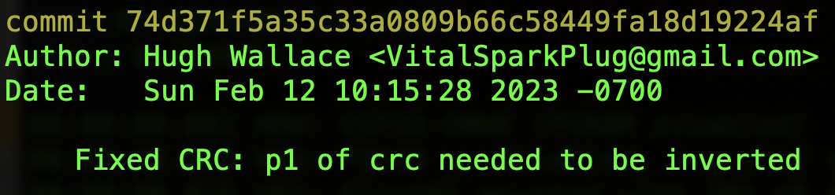
add files and commit to your repo’
Me
mkPie
.git
pie.py
crust.py
topping.py
Notes:
Once your skeleton files are created… you add files and commit ALL the files to your repo’
The commit gets a URI, Date, Author and most importantly a
modification string. Git log will list all the commits Its all stored in the .git
A warning to even competent hackers!!! You know who you are ! DO NOT even think about editing anything in the .git directory… It hidden for a very very good reason.
Every commit has a log entry that has a very big hex number. This is a URI (Uniform Resource Identifier)
Your more familiar with URL (Uniform Resource Locator) A unique address on the internet.
This URI names a unique state which can be returned to or compared to.

Slide 17
Push your repo’ to the cloud
Me
mkPie
.git
pie.py
PatPeteProject
Push
crust.py
topping.py
Notes:
There is a git repository (repo’) that is somewhere in the cloud or you employers network.

Slide 18

Pete can now clone your cloud repo
Me
Pete
mkPie
mkPie
mkPie
mkPie
mkPie
.git
.git
.git
.git
.git
Clone
pie.py
pie.py
pie.py
pie.py
pie.py
PatPeteProject
crust.py
crust.py
topping.py
crust.py
topping.py
crust.py
topping.py
crust.py
topping.py
topping.py
git clone http://github.com/CSU-B111-LAB/PatPeteProject
Notes:
Pete uses
Git clone http://github.com/B111Lab/PatPeteProject

Slide 19
Each has the same files! 🤨!?
Me
Pete
mkPie
mkPie
.git
.git
pie.py
pie.py
PatPeteProject
crust.py
topping.py
crust.py
topping.py
Notes:
Ahh! Each has the same files I hear you say.

Slide 20
Each has the same files! 🤨!? 😱?
Me
Pete
mkPie
mkPie
.git
.git
pie.py
pie.py
PatPeteProject
crust.py
topping.py
crust.py
topping.py
Notes:
But some files are for Pete to work on.
He does NOT rename files to “SAVE” state.
Simply create , modify , debug code in ANY file ! NO Renaming.
You can refactor to add or remove files too.

Slide 21
Each has the same files!
Me
Pete
mkPie
mkPie
.git
.git
pie.py
pie.py
PatPeteProject
crust.py
topping.py
crust.py
topping.py
Notes:
When Pete is happy with his modifications to the files.
He stages wanted files first… in case he made some temporary files NOT needed in the project
He the commits to his local repo be careful to add a modification string, saying what he has done .
Merging will deal with this soon.

Slide 22
Pete adds, commits and pushes
Me
Pete
mkPie
mkPie
.git
.git
pie.py
pie.py
PatPeteProject
Push
crust.py
topping.py
crust.py
topping.py
Notes:
Pete does what you did.
Commits with a modification string and then
Pushes the changes to the cloud

Slide 23
Git will help you merge duplicate files
Me
Pete
mkPie
mkPie
.git
.git
pie.py
pie.py
pie.py
PatPeteProject
Pull
topping.py
crust.py
topping.py
crust.py
topping.py
Notes:
You now pull from the cloud… where the code is safe and documented what has changed.
How do you know that the repo changes? There is a git command that tells you that there is a newer head.
Pete could also txt you …. “Just committed the changes I made… see you after spring break :-) “

Slide 24
Git merge
git merge tool
Simple cli version
Many slick GUI merge tools are available
Notes:
When you pull. If Pete only added to files you didn’t change then they will update with Pete’s stuff.
If he edited a file that you edited then merging is the process of deciding if the edits clash or are harmonious.

Slide 25
Git will help you merge duplicate files
Me
Pete
mkPie
mkPie
.git
.git
pie.py
pie.py
pie.py
PatPeteProject
crust.py
topping.py
crust.py
topping.py
topping.py
Notes:
Merging happens ….
You NOW have the same files again.
BUT Pete will not have what you have edited after you last push.!!!!!!!!
For that I need to Commit the push to the Cloud GIT Repo’ and Pete needs to pull possibly merging like I just did but accepting ALL my changes … If he trusts I did it correctly ;-)

Slide 26
The End

Slide 27
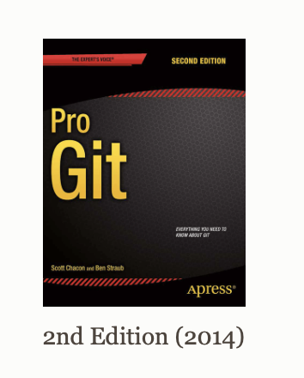
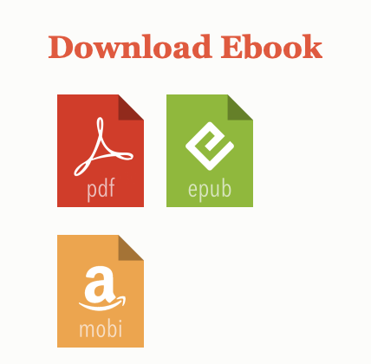
https://git-scm.com/book/en/v2
Free book!
If you love it … Buy paper one!
First 8 chapters only ( page 108)
It has (800 pages! )
Notes:
If you are a Computer science or Computer Engineering . YOU should read the whole thing and be very super guru level knowledgable. Add it to your resume…
Git at high levels is very powerful … but can get messed up due to not quite understanding it! Those engineers who can wield git at Gandalfs levels are revered in ANY org.

Slide 28
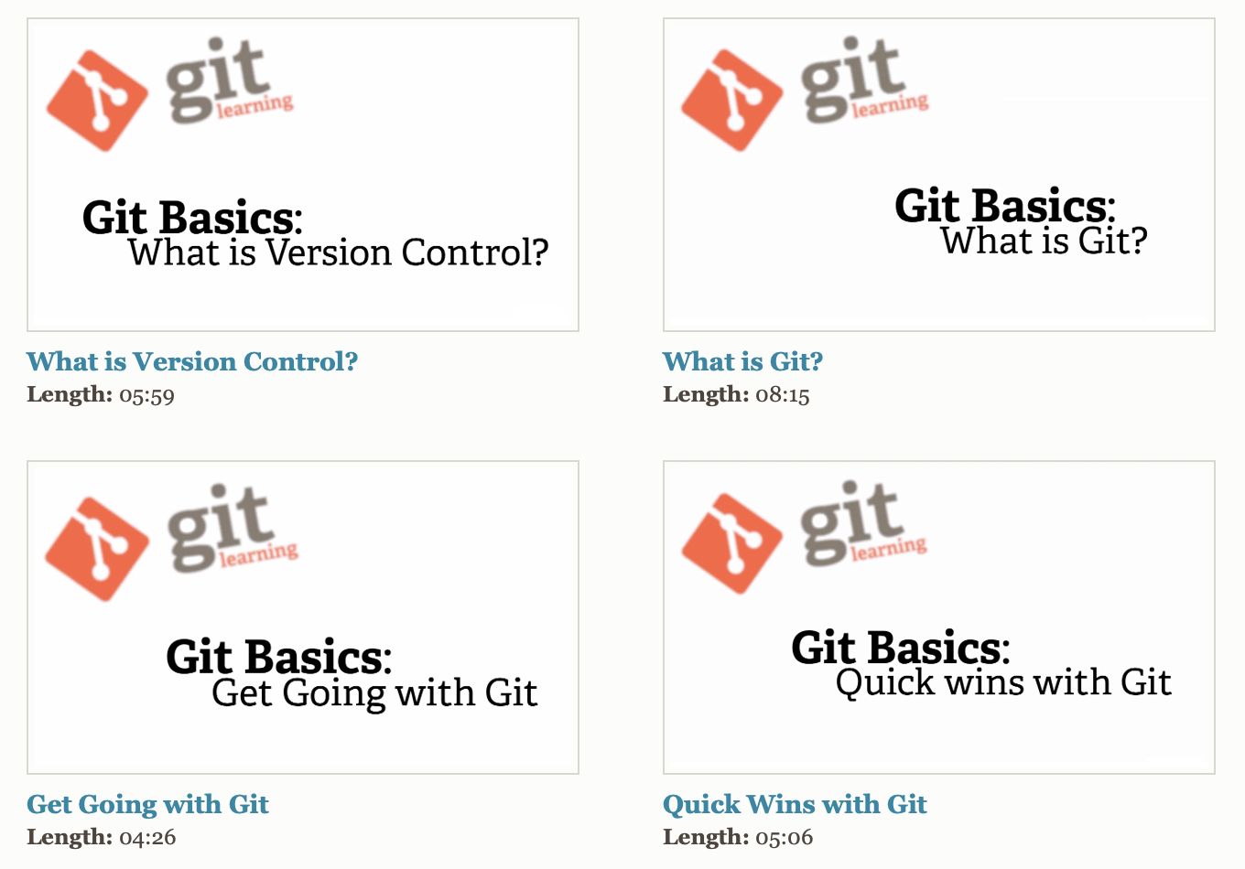
Videos for the Dyslexic … Me!
Notes:
Nice concise videos…
And there is YouTube!

Slide 29
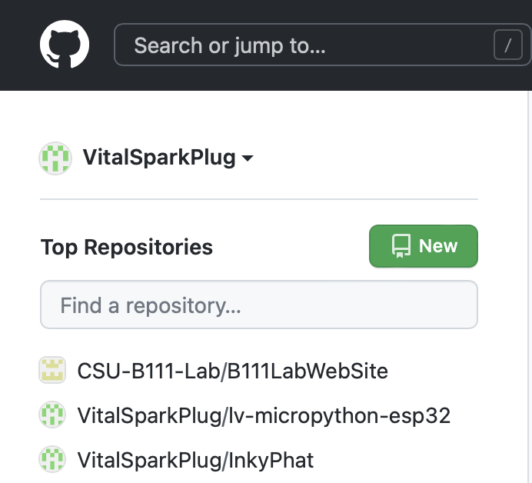
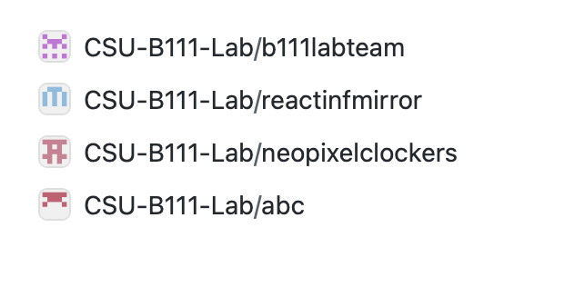
GitHub.com
Get an account
You can make it private
I set up a CSU-B111-LAB team site where …
Only team members can have share private repo’s
The also have virtual machines you can use for free!

Slide 30
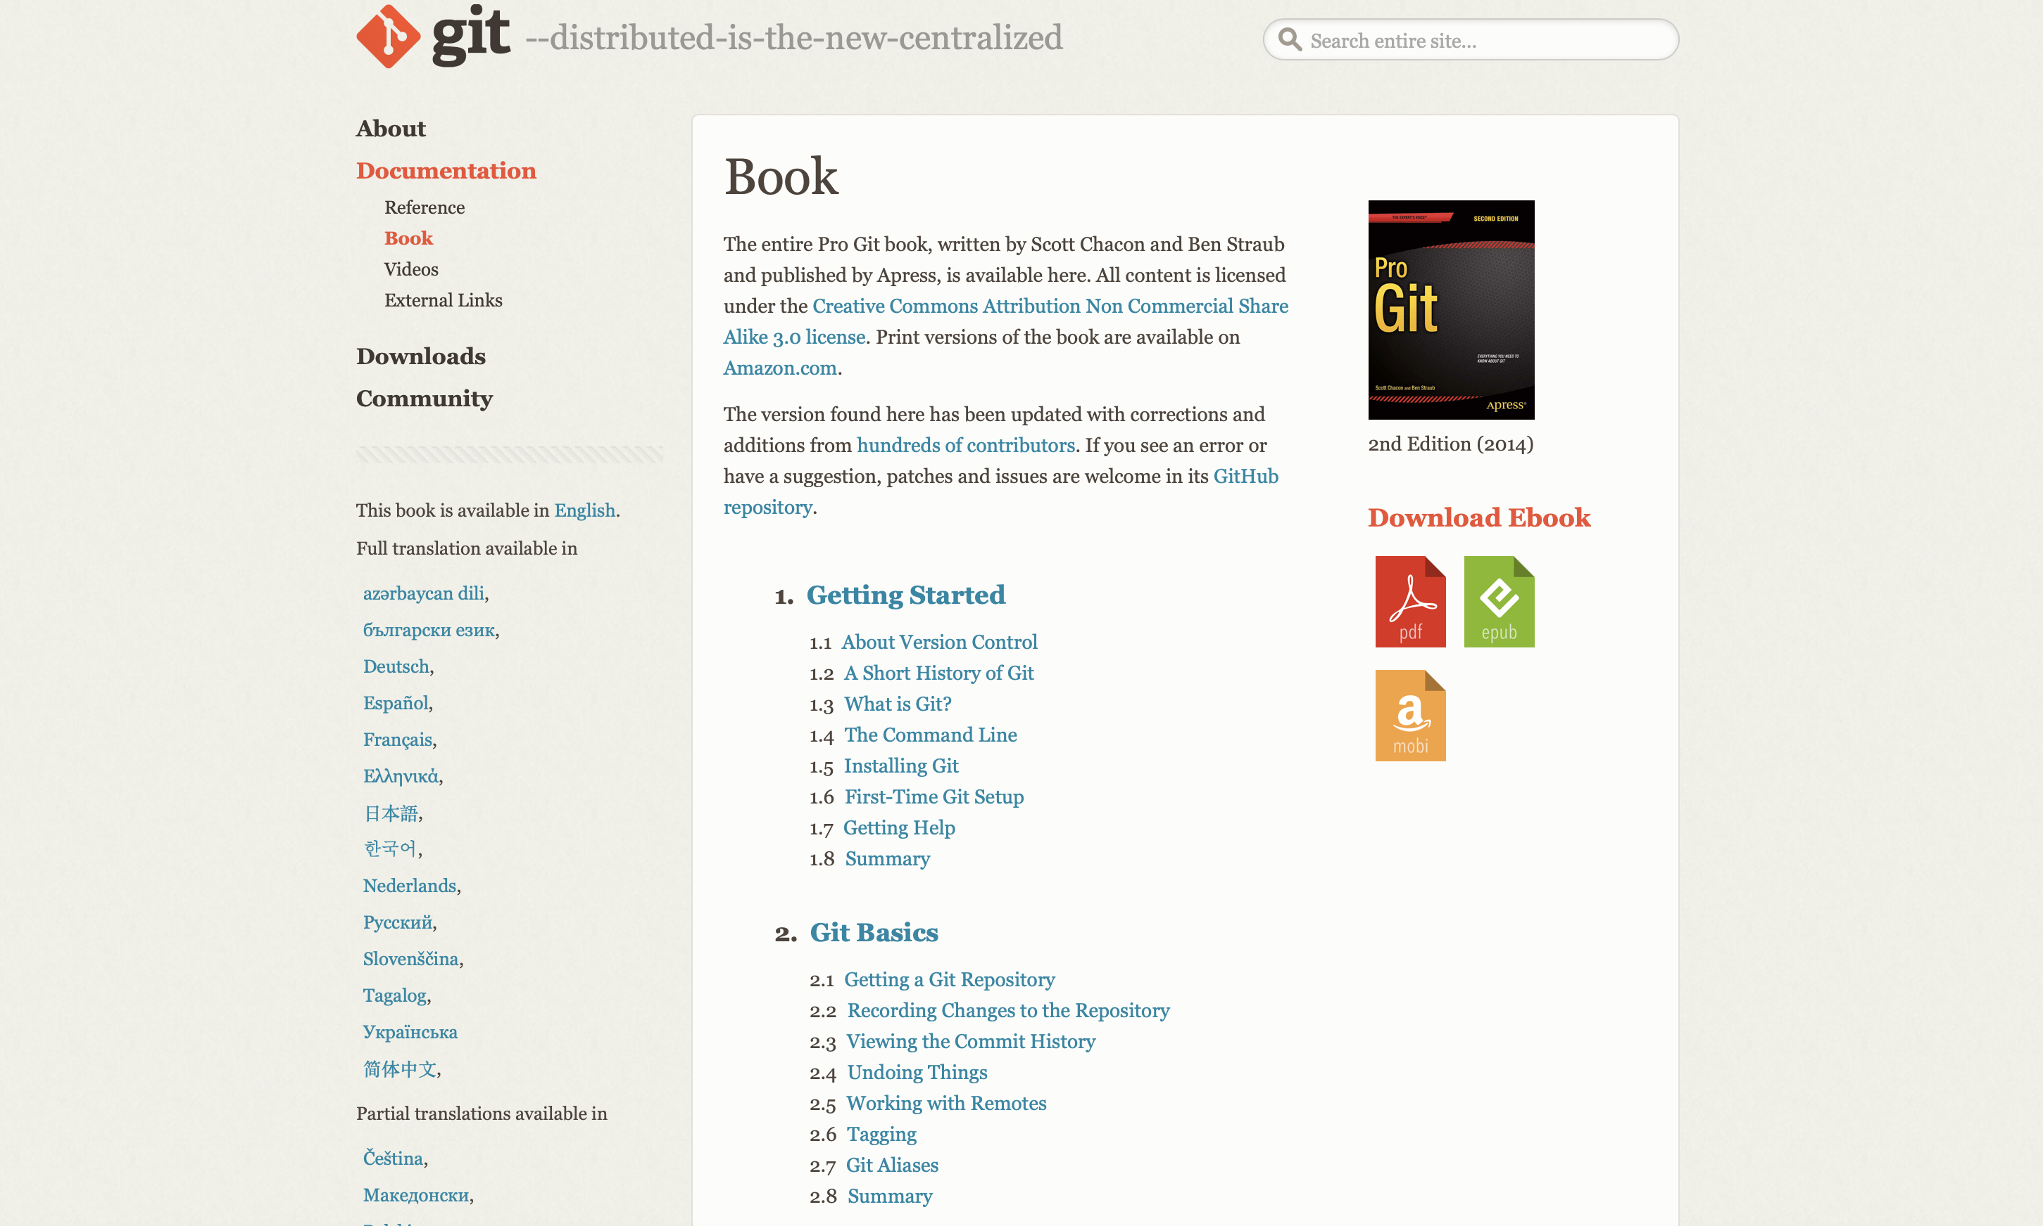
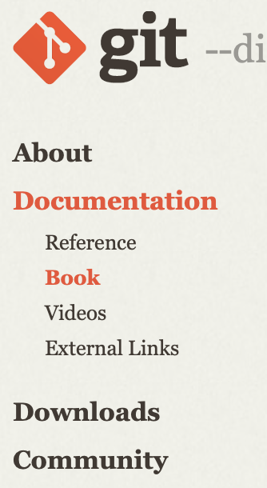
https://git-scm.com/book/en/v2

Slide 31
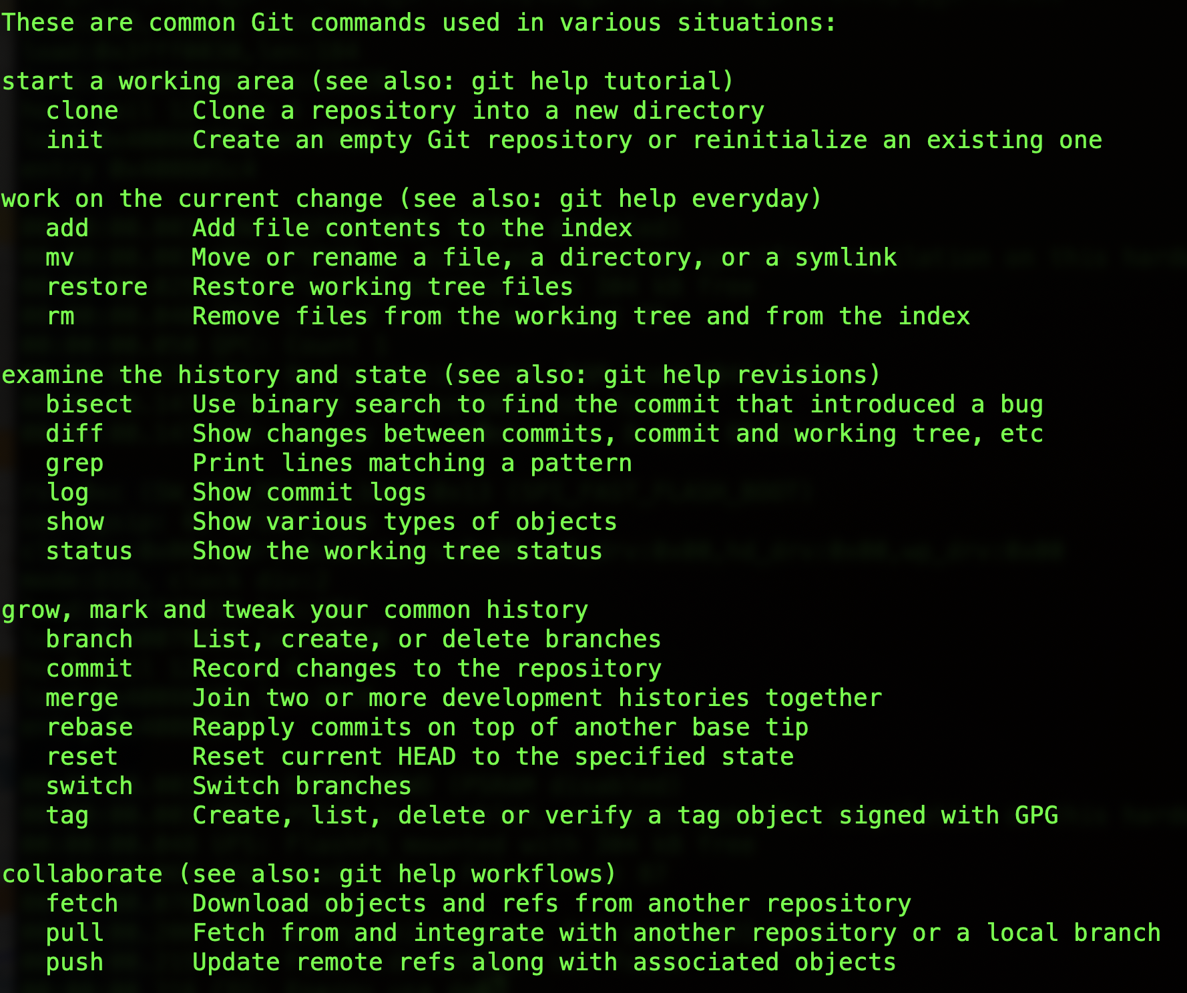
Git CLI (Mac,Linux,PowerShell)
C:> git help

Slide 32
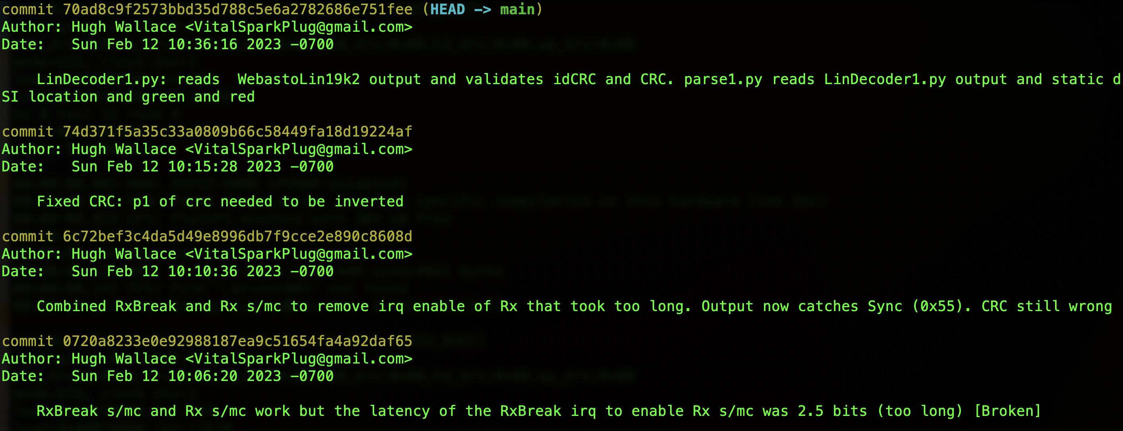
git log

Slide 33
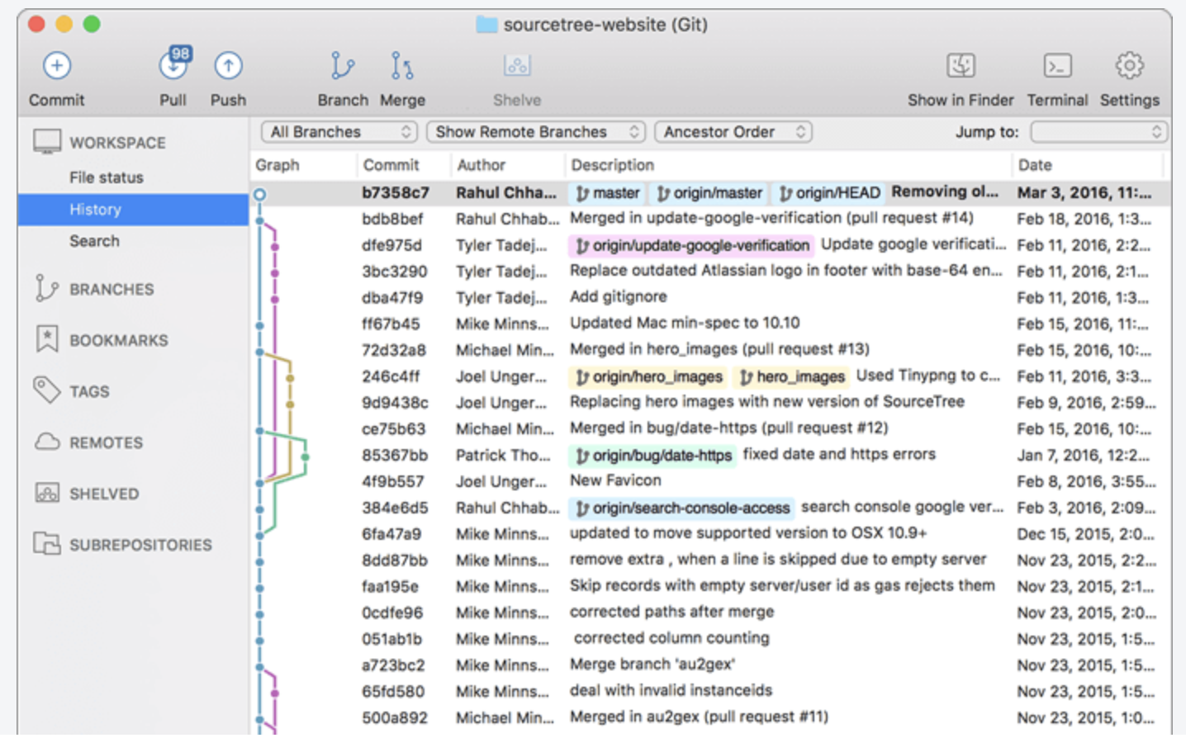
SourceTree (Mac)

Slide 34
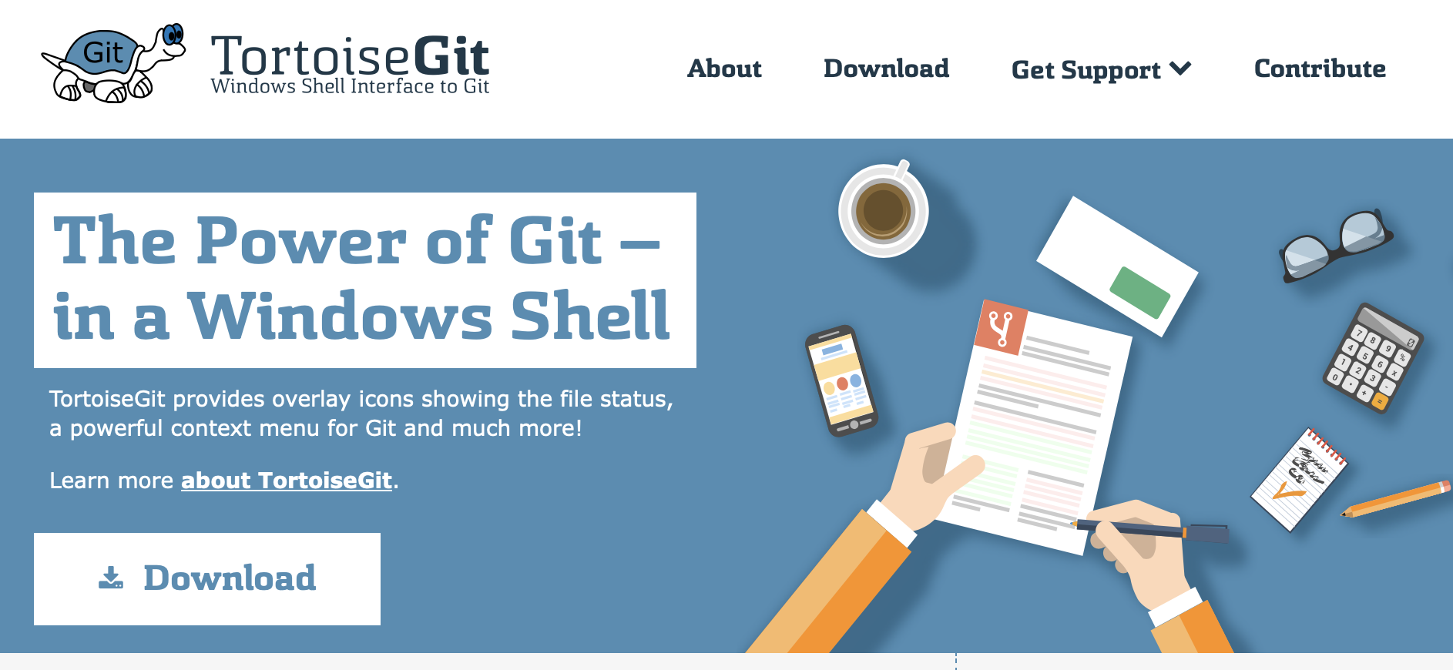
TortoiseGit (Win)

